Slide 1





Computational
Informatics &
Machine
Intelligence Lab
SEE-ME
A Medical Image Computing in Resources Constrained Setting Workshop & Knowledge Interchange (MIRASOL)
A Sensitivity-Gated Cascade for Compute-Efficient Spinal Lesion Detection in Resource-Constrained Settings
Prosenjit Mondol¹ • Samrat Kumar Dey² • Arpita Howlader¹
91.03%
40.10%
¹ Faculty of Computer Science and Engineering, Patuakhali Science and Technology University
² School of Science and Technology, Bangladesh Open University
AUROC
mAP@0.5
DERNet
YOLO11-L
MIRASOL • MICCAI 2026
01

Slide 2
Research Motivation
Why spinal radiograph AI needs sensitivity, localization, and resource awareness
• Spinal radiographs are a primary screening modality for a wide spectrum of spinal pathologies.
• Radiologists must interpret complex 3D bony anatomy projected onto a 2D plane, creating substantial visual ambiguity.
• Many lesions are minute and can occupy less than 1% of the field of view, while overlapping anatomy can obscure subtle findings.
• The long-tailed lesion distribution creates a strong learning bias toward abundant pathology.
• A practical low-resource workflow should not spend heavy detector computation on every normal study.
Clinical challenge
Visual ambiguity and subtle lesions can contribute to missed or delayed diagnosis.
Statistical challenge
Dominant classes can overwhelm rare-lesion learning.
Resources Constrained Triage
Heavy localization models are computationally expensive when applied universally.
MIRASOL • MICCAI 2026
02

Slide 3
Research Gap
Where the paper positions the proposed framework
• VinDr-SpineXR introduced a multi-lesion benchmark and baseline classifiers, but its strong long-tail distribution remains difficult.
• Single-disease systems, such as osteophyte-focused approaches, do not provide broad multi-lesion screening.
• Conventional two-stage and one-stage detectors can struggle with the combination of minute lesions and rare foreground classes.
• Vision Transformer approaches may be less efficient to train on smaller, imbalanced spinal datasets.
• Focal-loss-based approaches help difficult examples, but the paper argues that rare minute lesions still need architectural prioritization.
• This work combines heterogeneous high-sensitivity triage, a customized detector, imbalance mitigation, explainability, and staged computation.
MIRASOL • MICCAI 2026
03

Slide 4
Clinical & Technical Challenges
46.9 : 1
< 1%
15.4 GFLOPs
class imbalance
lesion area / FOV
DERNet screening cost
A • Sensitivity / specificity
B • Extreme imbalance
C • High computational overhead
A monolithic model must simultaneously decide whether a study is abnormal and localize fine-grained lesions.
The dataset is dominated by Osteophytes while rare categories have far fewer annotations.
Running a 74.6-GFLOP detector on every study is undesirable in constrained environments.
Design implication → screen first, localize second.
MIRASOL • MICCAI 2026
04

Slide 5
Research Objective & Contributions
Five design decisions define the proposed system
Objective
Create a sensitivity-gated cascade that filters normal radiographs efficiently and reserves detailed lesion localization for abnormal candidates.
01 Sensitivity-gated triage
02 Minute-lesion localization
DERNet combines DenseNet121, EfficientNetV2-S, and ResNet50 using weighted soft voting.
Customized YOLO11-L with CSP-Darknet, C2PSA attention, PANet, and multi-scale heads.
03 Imbalance mitigation
04 Explainability
Focal loss and 20% copy-paste augmentation address rare foreground classes.
Saliency Map, Grad-CAM, and LIME test alignment with authentic lesion regions.
05 Compute-aware routing
Normal studies can exit before the heavy localization stage.
MIRASOL • MICCAI 2026
05

Slide 6
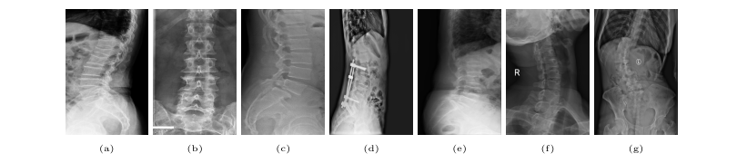
VinDr-SpineXR: scale, split, and lesion heterogeneity
Scale, split, and seven expert-annotated lesion categories
10,466
8,389
2,077
7 lesion categories
total radiographs
training images
independent test
8,389 train + 2,077 independent test
model development
final evaluation
Representative examples from the benchmark
Evaluation protocol
• 5-fold cross-validation for training/model development
• Independent test set: 2,077 images
• Detection evaluated across seven lesion categories
Seven lesion categories are visually heterogeneous and can occupy only a small fraction of the field of view.
Dataset: VinDr-SpineXR benchmark
MIRASOL • MICCAI 2026
06

Slide 7
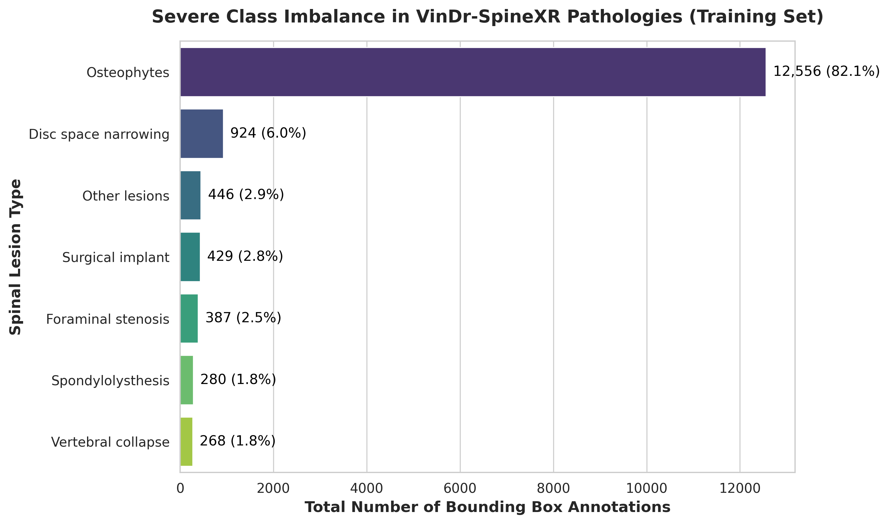
Lesion Distribution & Class Imbalance
The long tail directly motivates the detector's loss and augmentation strategy
82.1%
1.8%
46.9:1
Osteophytes share
Vertebral Collapse
max:min imbalance
12,556 boxes
268 annotations
reported ratio
Dominant class
Osteophytes contributes the majority of annotated boxes and can dominate learning.
Rarest class
Vertebral Collapse has only 268 annotations in the reported dataset.
Training implication
The detector needs explicit emphasis on hard and underrepresented foreground instances.
MIRASOL • MICCAI 2026
07

Slide 8
Proposed Cascaded Framework: Structural Decoupling
1. Adaptive Preprocessing
2. Stage 1: DERNet
3. Stage 2: YOLO11-L
• Raw radiographs ingested at 640×640×3.
• CLAHE equalizes exposure across different X-ray machines.
• Clip limit prevents noise amplification in dense bone.
• Prepares clean, normalized inputs for both stages.
• Heterogeneous ensemble: DenseNet121 + EfficientNetV2-S + ResNet50.
• Lightweight CPU execution: 15.4 GFLOPs, 120 ms latency.
• Tuned decision threshold: tau* = 0.4787.
• Normal studies exit early; abnormal studies are routed forward.
• Triggered only on flagged abnormal radiographs.
• C2PSA spatial attention suppresses background artifacts.
• PANet feature fusion captures minute lesions.
• Predicts fine-grained bounding boxes across 7 lesion classes.
MIRASOL • MICCAI 2026
08
Notes:
Here is the core thesis of the paper: structural decoupling. Rather than forcing a monolithic detector to perform screening and localization simultaneously, we decouple the pipeline: DERNet screens everyone quickly with high sensitivity, and only abnormal studies trigger the computationally heavier YOLO11-L detector.

Slide 9
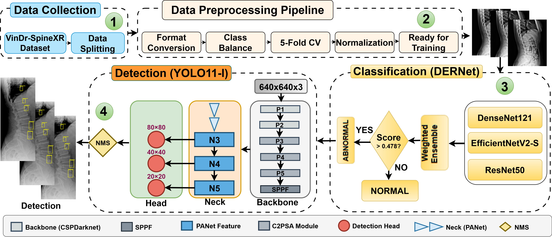
Architecture of cascade framework
Input + preprocessing
DERNet gate
YOLO11-L localization
Fig: Architecture of the cascaded framework for spinal lesion triage and localization.
MIRASOL • MICCAI 2026
09

Slide 10
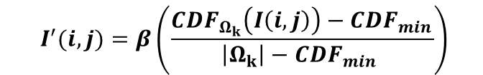
Adaptive Preprocessing — CLAHE Optimization
Handling exposure variation before classification and detection
• Tile Grid (Ωk = 8×8): Defines local contextual regions to calculate Cumulative Distribution Functions.
• Dynamic Range Scaling (β = 255): Rescales normalized local intensities back to standard 8-bit image depth.
• Clip Limit (τ = 2.0): Suppresses local contrast over-amplification, capping noise in homogeneous vertebral bone.
Why Standard Equalization Fails in X-Rays
• Global histogram equalization over-enhances background scatter and bone marrow noise, generating false-positive lesions.
• CLAHE operates locally to amplify micro-contrast specifically around cortical bone margins.
• Reveals minute osteophytes and subtle disc space narrowing obscured by uneven exposure across hospital scanners.
• Crucial foundation before feeding images into downstream convolutional backbones.
To mitigate radiographic exposure variance CLAHE computes the enhanced intensity by mapping the local CDF as
$$I^{′}(i,j)=β\left(\frac{CDF_{Ω_{k}}\left(I\left(i,j\right)\right)−CDF_{min}}{\left|Ω_{k}\right|−CDF_{min} }\right)$$
MIRASOL • MICCAI 2026
10

Slide 11
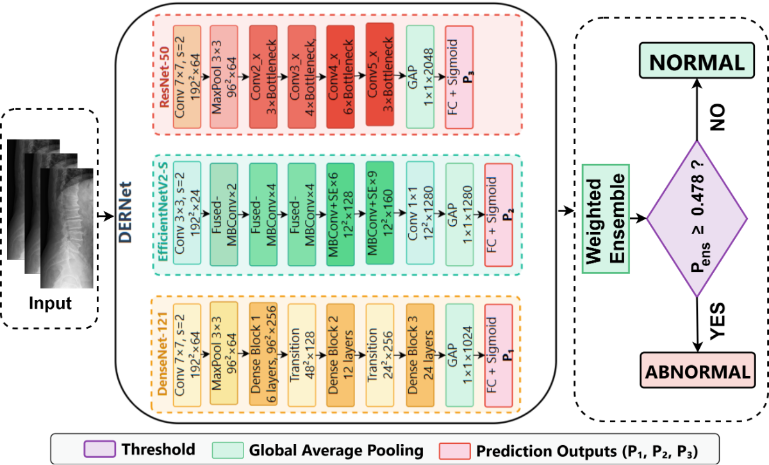
Stage 1: DERNet Heterogeneous Ensemble
Three complementary CNN backbones are fused at the probability level.
DenseNet121
ω₁ = 0.42
textural sensitivity / subtle anomalies
EfficientNetV2-S
ω₂ = 0.32
specificity-oriented false-positive control
ResNet50
ω₃ = 0.26
recall-oriented fail-safe for gross
abnormalities
Fig: DERNet probabilistic ensemble architecture for high-sensitivity radiographic triage.
MIRASOL • MICCAI 2026
11

Slide 12
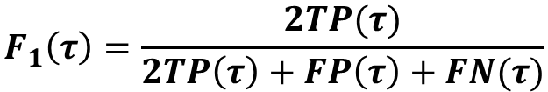

DERNet Soft Voting & Threshold Selection
Threshold Grid Search Optimization
Triage Decision Rule & Clinical Routing
$$τ^{∗}=arg max_{τ∈\left[0.35, 0.60\right]} F_{1}(τ)$$
• Decision Rule 1: If P_ens ≥ 0.478 → Flag as Abnormal → Route immediately to Stage 2 (YOLO11-L).
• Decision Rule 2: If P_ens < 0.478 → Flag as Normal → Exit pipeline early without consuming detector compute.
• Weight grid search (Δω = 0.01, Σω = 1.0) confirmed Ω = [0.42, 0.32, 0.26] as the global Pareto optimum.
• Harmonizes individual model biases into a single high-precision gatekeeper.
$$F_{1}\left(τ\right)=\frac{2TP(τ)}{2TP\left(τ\right)+FP\left(τ\right)+FN(τ)}$$
• Exhaustive search over [0.35, 0.60] with step size Δτ = 0.0002.
• Calibrated strictly on training folds to maximize cross-validation F1.
• Optimal threshold locked at τ* = 0.4787.
• Weighted soft-voting ensemble probability:
P_ens = 0.42·P_Dense + 0.32·P_EffNet + 0.26·P_ResNet
MIRASOL • MICCAI 2026
12

Slide 13
Backbone Complementarity & Ablation
Each member is given a functional role supported by ablation evidence
Backbone | Role described in paper | Weight | Ablation evidence
DenseNet121 | Textural sensitivity / subtle anomalies | 0.42 | Largest fusion weight
EfficientNetV2-S | Specificity / false-positive control | 0.32 | +19 FPs; −1.78% specificity if removed
ResNet50 | Recall fail-safe / gross abnormalities | 0.26 | +20 FNs; −1.99% sensitivity if removed
DenseNet121
EfficientNetV2-S
ResNet50
Dense connectivity supports multi-scale feature reuse for subtle boundary / texture abnormalities.
Its removal increases false positives, supporting its specificity-oriented contribution.
Its removal increases false negatives, supporting its recall-oriented contribution.
MIRASOL • MICCAI 2026
13

Slide 14
Stage 2: Customized YOLO11-L for Localization
Fine-grained lesion localization for minute spinal pathology
Backbone: CSP-Darknet + C2PSA
Neck: PANet feature fusion
Head: multi-scale detection
• Cross-Stage Partial connections ensure gradient flow while reducing redundant compute.
• C2PSA (Cross-Stage Partial with Spatial Attention) preserves high-frequency edge gradients.
• Suppresses background anatomical noise across lung and pelvis regions.
• Secures 41.40% AP on minute foraminal stenosis.
• Path Aggregation Network with bidirectional feature pyramid flow.
• Fuses shallow high-resolution spatial maps with deep semantic maps (N3 to N5).
• Preserves fine-grained pathology signals (<0.25% FOV, <32×32 px).
• Prevents small lesion coordinates from vanishing during successive pooling.
• Triple-grid prediction heads:
-> 80×80: Dedicated to minute bone spurs and stenosis.
-> 40×40: Mid-scale disc space abnormalities.
-> 20×20: Macro-scale vertebral dislocation.
• Filtered via decoupled Non-Maximum Suppression (NMS).
MIRASOL • MICCAI 2026
14
Notes:
For Stage 2, we customized YOLO11-L with C2PSA spatial attention and PANet feature fusion. The 80x80 spatial head is essential: it gives us fine spatial granularity to bound tiny lesions that occupy less than 0.25% of the field of view.

Slide 15
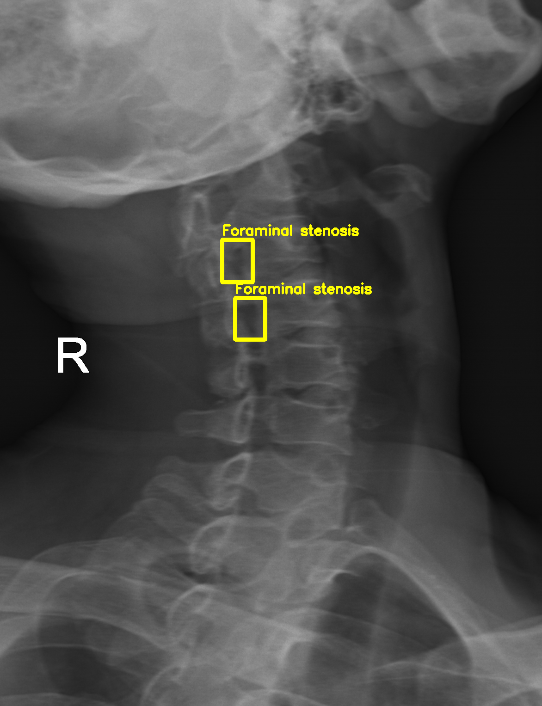
Multi-Scale Detection & Small-Lesion Handling
Why three detection resolutions are used
N3
N4
N5
80 × 80
fine spatial detail
40 × 40
mid-scale context
20 × 20
coarse context
Fig: Mid-Scale or Minute lesions
N3 — 80×80
N4 — 40×40
N5 — 20×20
More spatial cells represent minute lesions with less down sampling.
Adds intermediate context for distinguishing small pathology from adjacent anatomy.
Provides coarse anatomical context for larger abnormalities.
Together, the hierarchy balances local precision and broader spinal context.
MIRASOL • MICCAI 2026
15

Slide 16


Loss Design & Targeted Copy-Paste Augmentation
Focal loss + copy-paste augmentation target difficult and rare foreground instances
Composite Objective & Focal Formulation
20% Copy-Paste Augmentation Ablation
${FL}_{\left(p_{t}\right)}=−α_{t}{\left(1 − p_{t}\right)}^{γ}log(p_{t})$
40.10%
With Augmentation
Full pipeline
37.70%
Without Augmentation
Baseline ablation
$$𝓛_{total}= λ_{box}𝓛_{CIoU}+ λ_{cls}𝓛_{Focal}+ λ_{dfl}𝓛_{DFL}$$
• Standard COCO loss weights: $λ_{box}$= 7.5, $λ_{cls}$ = 0.5, $λ_{dfl}$= 1.5.
• Empirically tuned focal parameters: γ = 2.0, α_t = 0.25.
• Down-weights easy, background negative samples and majority osteophytes.
• Focuses back-propagation gradients on hard-to-detect rare minority classes.
Empirical Validation (+2.40% mAP@0.5 Gain):
• Ablating copy-paste drops detection accuracy by 2.40%.
• Reinforces rare pathologies (vertebral collapse, implants) during training.
• Synthesizes realistic pathological co-occurrences without manual radiograph acquisition.
MIRASOL • MICCAI 2026
16

Slide 17
Experimental Setup
Implementation and evaluation protocol reported by the authors
Item | Reported setting
Framework | PyTorch 2.0.1
GPU | NVIDIA RTX 3050 • 8 GB memory
Cross-validation | 5-fold
Reproducibility | Deterministic algorithms
Random initialization | Seed = 42
Classification metrics | AUROC • F1 • Sensitivity • Specificity
Detection metric | AP at IoU = 0.5 • mAP@0.5
Image-level task
Binary abnormality screening evaluates whether the gate identifies studies that require further analysis.
Lesion-level task
The detector evaluates localization across the seven lesion categories at IoU 0.5.
Reproducibility
We reports deterministic algorithms and a constant initialization seed.
MIRASOL • MICCAI 2026
17

Slide 18
Classification Results: DERNet vs. Baselines
DERNet vs. individual backbones and established baselines
Method | AUROC (%) | F1 (%) | Sens. (%) | Spec. (%)
EfficientNetV2-S | 89.44 | 79.34 | 70.80 | 91.12
ResNet50 | 88.88 | 80.15 | 82.72 | 78.13
DenseNet121 | 86.93 | 79.55 | 80.39 | 79.32
VinDr Ensemble | 88.61 | 81.06 | 83.07 | 79.32
HealNNET | 88.84 | 81.20 | – | –
DERNet | 91.03 | 83.09 | 84.91 | 81.68
91.03%
AUROC
84.91%
Sensitivity
83.09%
F1
81.68%
Specificity
Interpretation
Weighted soft voting harmonizes different backbone biases.
MIRASOL • MICCAI 2026
18

Slide 19
Detection Benchmark: Evaluation Across 7 Lesion Classes
Method | LT2 | LT4 | LT6 | LT8 | LT10 | LT11 | LT13 | mAP@0.5
Dino | 16.58 | 22.87 | 28.53 | 32.71 | 59.78 | 41.28 | 3.24 | 29.28
RetinaNet | 14.53 | 25.35 | 41.67 | 32.14 | 65.49 | 51.85 | 5.30 | 28.09
Faster R-CNN | 22.66 | 35.99 | 49.24 | 31.68 | 65.22 | 51.68 | 2.16 | 31.83
Sparse R-CNN | 20.09 | 32.67 | 48.16 | 45.32 | 72.20 | 49.30 | 5.41 | 33.15
VinDr-SpineXR | 21.43 | 27.36 | 34.78 | 41.29 | 62.53 | 43.39 | 4.16 | 33.56
EGCA-Net | 22.36 | 29.75 | 36.73 | 44.69 | 66.58 | 50.41 | 2.09 | 36.09
YOLOv6 | 23.60 | 34.90 | 38.40 | 37.50 | 67.30 | 43.30 | 3.35 | 35.50
YOLOv12 | 23.60 | 37.70 | 37.00 | 45.90 | 67.00 | 49.80 | 4.01 | 37.90
Ours (YOLO11-L) | 26.70 | 41.40 | 40.60 | 54.80 | 74.10 | 51.20 | 2.99 | 40.10
(*) LT2, LT4, LT6, LT8, LT10, LT11, LT13 denotes for disc space narrowing, foraminal stenosis, osteophytes, spondylolisthesis, surgical implant, vertebral collapse and other lesions, respectively.
MIRASOL • MICCAI 2026
19

Slide 20
Ablation Study - Component Impact Analysis
Component Removed | mAP@0.5 | ΔmAP | Impact Level
- Copy-Paste Augmentation | 37.7% | -2.40% | High
- Mosaic Augmentation | 37.1% | -2.94% | High
- C2PSA Module (Attention) | 38.5% | -1.54% | Medium
- Focal Loss | 38.9% | -1.14% | Medium
- Task-Aligned Assignment | 39.2% | -0.84% | Low
MIRASOL • MICCAI 2026
20

Slide 21
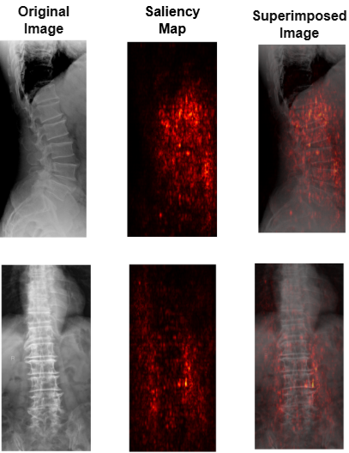
Explainable AI — Saliency Map
Saliency Map
Mean X-IoU = 0.61. Thresholded attention overlaps lesion regions / vertebral boundaries.
Interpretation: XAI is evidence of anatomical grounding, not a substitute for clinical validation.
MIRASOL • MICCAI 2026
21

Slide 22
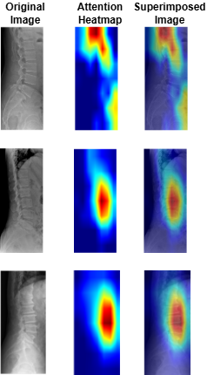
Explainable AI — Grad-CAM
Grad-CAM
Mean X-IoU = 0.64. Heatmaps align with the regions localized by YOLO11-L.
Interpretation: XAI is evidence of anatomical grounding, not a substitute for clinical validation.
MIRASOL • MICCAI 2026
22

Slide 23
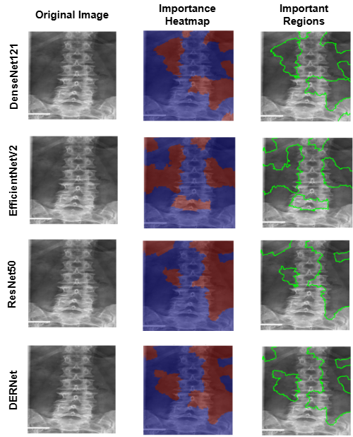
Explainable AI — LIME
LIME
Local importance highlights meaningful spinal structures rather than random background.
Interpretation: XAI is evidence of anatomical grounding, not a substitute for clinical validation.
MIRASOL • MICCAI 2026
23

Slide 24
Computational Efficiency & Staged Inference
Component | GFLOPs | Runtime Memory | Typical Latency | Notes
DERNet (screening) | 15.4 | 0.9 GB | 120 ms | Ultra-light screening stage; optimized for CPU inference.
YOLO11-L (detailed localization) | 74.6 | 1.8 GB | 350 ms | Executed only for abnormal cases to preserve compute budget.
Staged Pipeline (typical) | 15.4 (+74.6 if localized) | 0.9–1.8 GB | 120 ms (screening); +350 ms if localization invoked | Staging reduces average computation and supports practical CPU deployment.
MIRASOL • MICCAI 2026
24

Slide 25
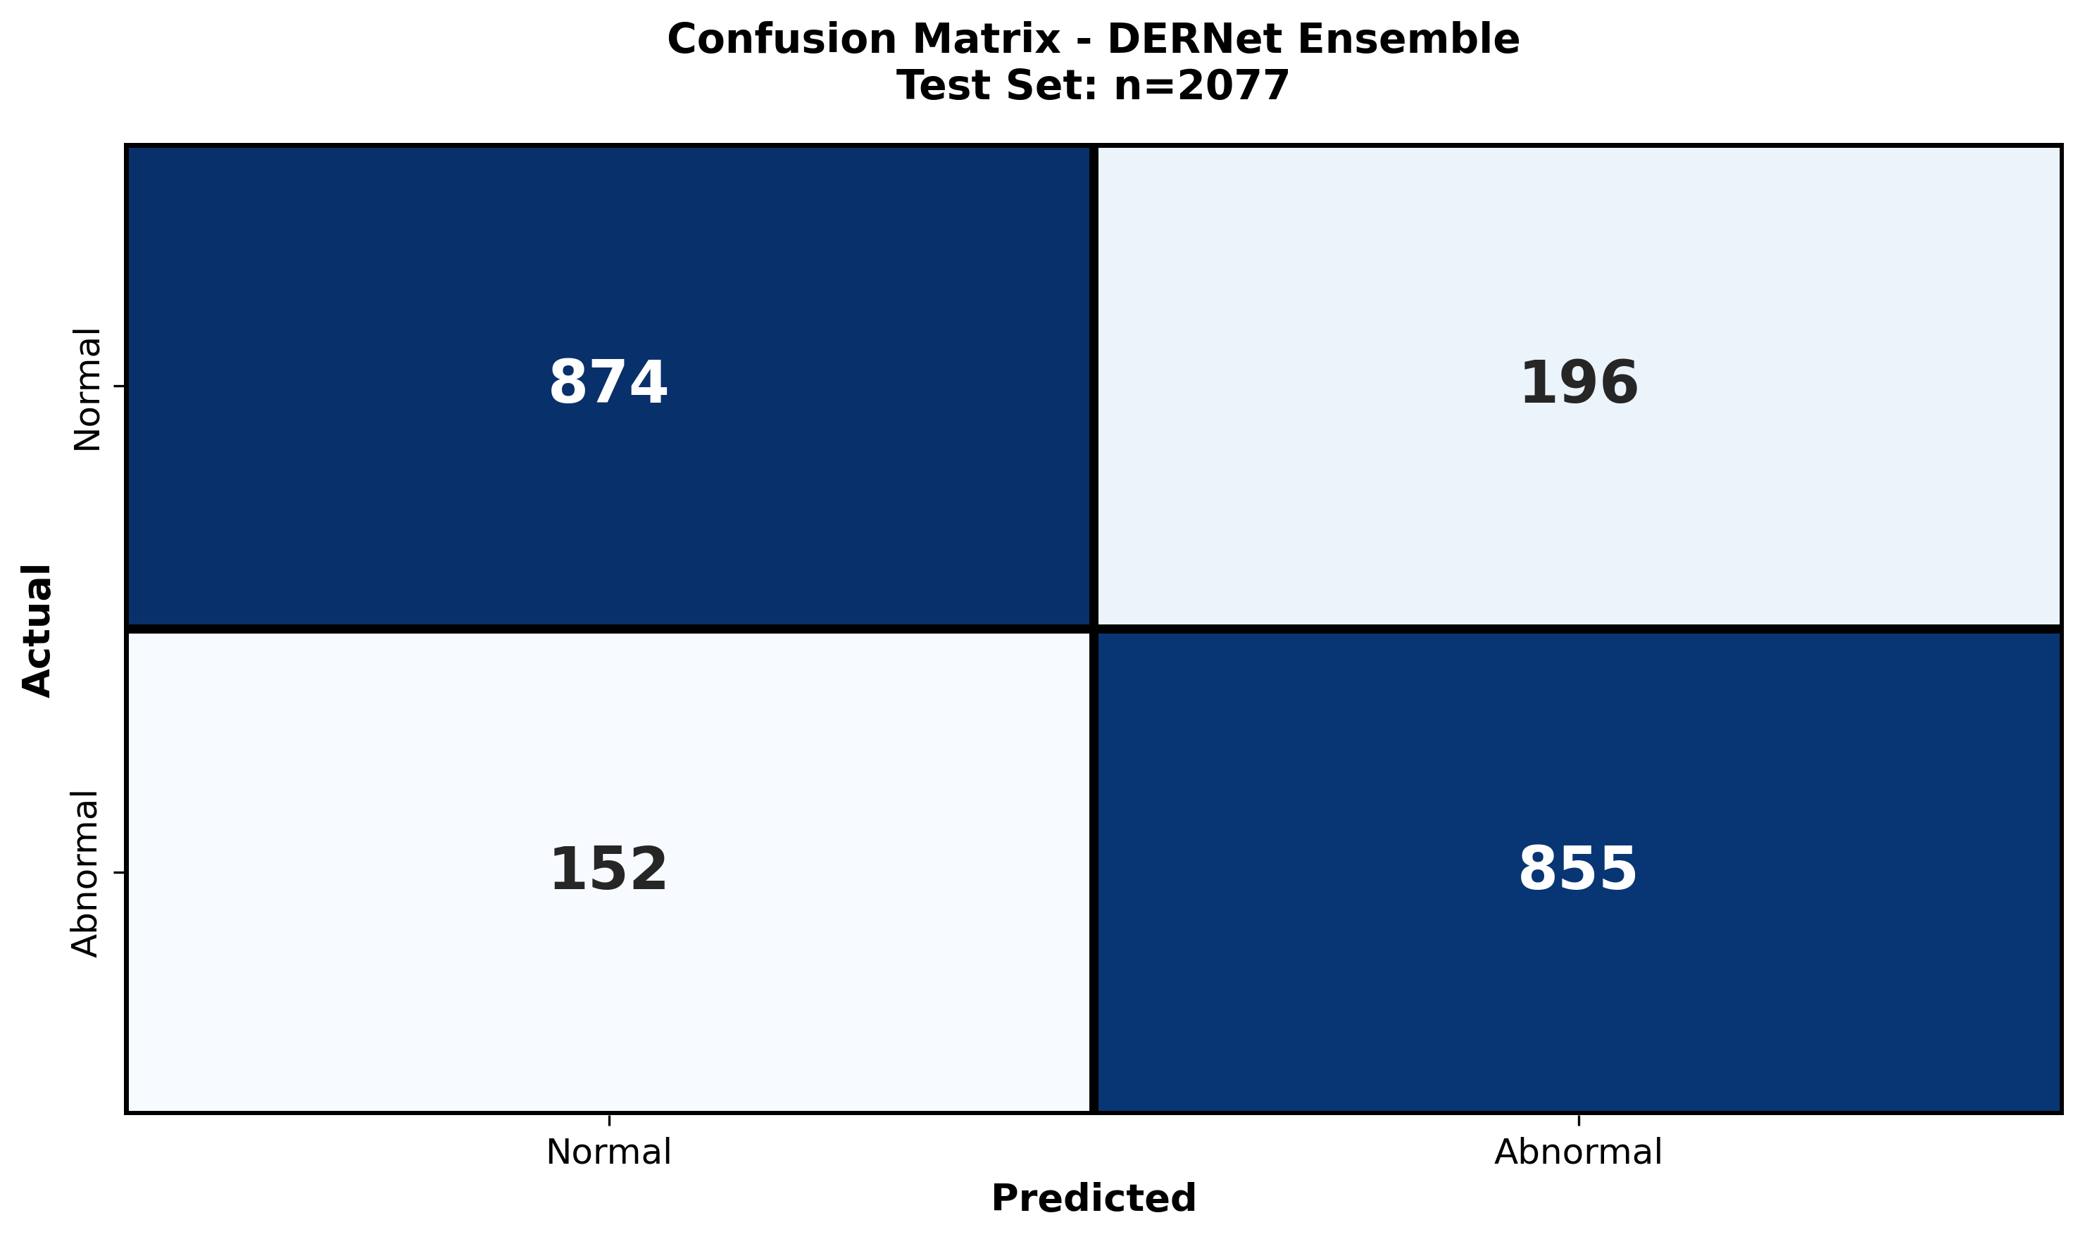
Error Analysis
MIRASOL • MICCAI 2026
25

Slide 26
Discussion, Limitations & Future Work
What this study demonstrates
Limitations reported
Future work reported
• Sensitivity-oriented image triage
• Fine-grained lesion localization
• XAI alignment with pathology
• Compute-aware routing
• Single-source dataset
• Rare categories remain difficult
• No longitudinal patient data
• External validation still needed
• Multi-center validation
• Better rare-lesion coverage
• Longitudinal radiographic analysis
• Broader deployment evaluation
Important framing
Our study proposes a screening / localization framework for spinal X-rays. It does not claim to replace MRI or clinical diagnosis.
MIRASOL • MICCAI 2026
26

Slide 27
Conclusion & Key Takeaways
• DERNet provides a high-sensitivity image-level gate using complementary DenseNet121, EfficientNetV2-S, and ResNet50 models.
• Customized YOLO11-L performs fine-grained multi-scale localization after abnormal routing.
• Focal loss and 20% copy-paste augmentation address the severe lesion imbalance.
• Saliency Map, Grad-CAM, and LIME provide complementary evidence that model attention aligns with spinal pathology.
• The staged design allocates expensive computation only where detailed localization is required.
MIRASOL • MICCAI 2026
27

Slide 28
Thank You
Pamela Ma’am
Thank you for your time, attention, valuable guidance,
and for agreeing to present our work at MIRASOL.
MIRASOL • MICCAI 2026
28

